Slide 1
Airbnb Price Analysis and Prediction using Deep Learning Algorithms

Slide 2
Group Member Information
Dingari, Vikram – 700742014
Shruthi Vallap Reddy – 700744517
Cherukupally, Ashwin Kumar Reddy – 700745488
Kadali, Satya Ishyanth - 700735513

Slide 3
Role/Responsibilities
Task | Responsibility | Contributions (%)
Data collection and preprocessing | Shruthi | 100
Model selection and architecture | Ashwin | 100
Feature engineering and implementation | Satya Ishyanth Vikram | 75% 25%
Model training and testing | Satya Ishyanth Vikram | 25% 75%
Final testing and documentation | Vikram , Satya Ishyanth , Shruthi | 33% 33% 33%

Slide 4
Motivation
The objective of this project is to do Descriptive analysis, Prescriptive analysis and Predictive analysis. With that analysis we will be able to answer the following questions.
Descriptive analytics
How many listings are available in the neighbourhood?
When are the prices high and low?
Which neighborhoods are considered safe for hosting?
Long-term rentals instead of leasing?
Presence of professional hosting service providers?

Slide 5
Motivation
Prescriptive
Based on the customer budget, they can either opt for an entire house or just a room or even better share a room.
With a range of prices as low as 700 to as high as 50,000, comes a range of amenities, such as selection on a number of beds, bedrooms, kitchen, air conditioning, heating washing machine, breakfast, beachfront, gym, pool etc to name a few.
Predictive Analytics
Which locations give the higher revenue ?
To predict the price based on the user selected attributes.

Slide 6
Objective
There are several reasons why this project is significant.
Firstly, the use of Bi-LSTM for Airbnb price prediction is a novel approach that has not been extensively explored in the literature.
By applying this deep learning model to the Airbnb dataset, we can take advantage of its ability to capture long-term dependencies and temporal patterns in the data, which can lead to more accurate and robust predictions.

Slide 7
Related Work
Understanding the factors that contributed to the growth of Airbnb and how it influences tourists is critical for the future of creative enterprises.
Analyzing the relationship between numerous attributes and how they differ while reflecting the price is crucial for hosts to choose features that contribute to the community's growth while keeping an eye on the price.
Regular modification of business models is necessary for continued growth and development.
Ratings provided by visitors are critical to convince others that a location is worth living in based on community suggestions.
The sharing economy plays a significant role in offering peer-to-peer lodgings, which impacts other lodging businesses' revenue.
Examining Airbnb from both visitor and competitor companies' perspectives is necessary to determine the reasons why consumers select Airbnb over hotels and if competitors are significantly impacted.
Technology has a significant role in the growth of Airbnb, enabling consumers to act as entrepreneurs and familiarize themselves with the concept of utilizing internet services to book and select a home in a certain location.

Slide 8
Problem Statement
Developing a reliable price prediction model for Airbnb rental properties using machine learning and natural language processing techniques to assist property owners and customers in evaluating prices with limited information available, while taking into account rental characteristics, owner attributes, and consumer feedback, with the goal of improving the accuracy of price predictions and facilitating fair pricing practices while minimizing negative impacts on surrounding neighborhoods.

Slide 9
Proposed Solution
Bi-LSTM model used for Airbnb price prediction.
Bi-LSTM is a type of RNN suitable for sequence prediction tasks.
Bi-LSTM model consists of two LSTM layers to capture past and future context of input sequence.
Trained on Airbnb New York dataset with 80/20 split, MSE loss function, and Adam optimizer.
Performance evaluated with RMSE, MAE, R-squared, and visualizations such as scatter and residual plots.
Bi-LSTM model tends to overestimate lower-priced listings and underestimate higher-priced listings.
Potential for refinement with additional features or different architectures and deployment in a production environment.

Slide 10
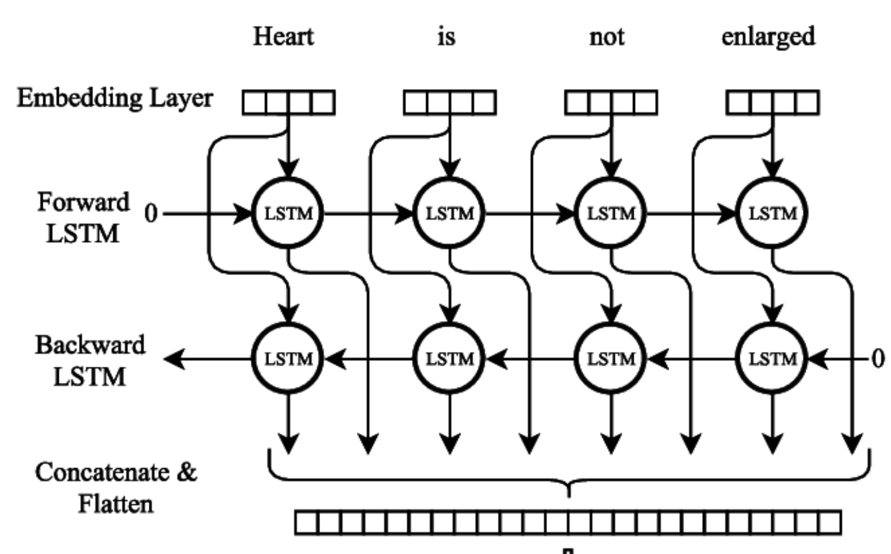
Fig 1: Bi-LSTM Architecture.
Image Source: Modelling Radiological Language with Bidirectional Long Short-Term Memory Networks, Cornegruta et al.[18]

Slide 11
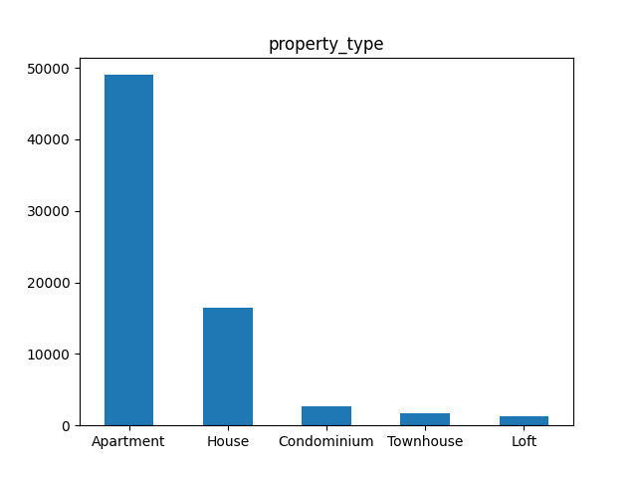
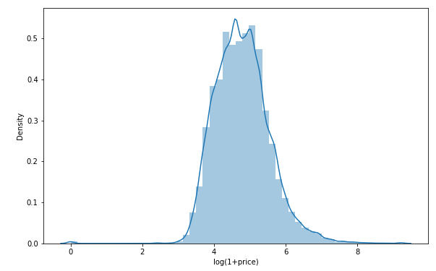
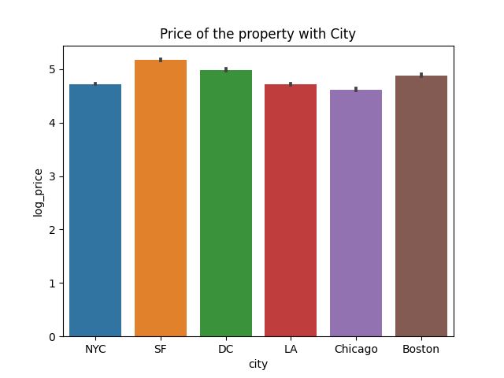
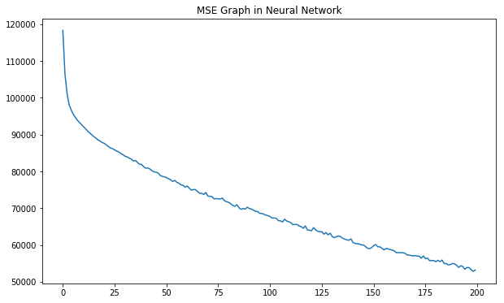
Results
Fig 2. Property types and their count.
Fig 3. Review scores and it’s count.
Fig 4. The price of the property is based on city.
Fig 5. Model loss during training and testing

Slide 12
Reference
Mao, Zhenxing, and Jiaylng Lyu, “Why travelers use Airbnb again?” International Journal of Contemporary Hospitality Management (2017).
Li, Yang, et al. “Price Recommendation on Vacation Rental Websites.”Proceedings of the 2017 SIAM International Conference on Data Mining. Society for Industrial and Applied Mathematics, 2017.
Moon, Hyoungeun, et a1. “Peer-to-peer interactions: Perspectives of Airbnb guests and hosts.” International Journal of Hospitality Management 77 (2019): 405-414.
Sheppard, Stephen, and Andrew Udell. “Do Airbnb properties affect house prices?” Williams College Department of Economics Working Papers 3.1 (2016): 43.
Dogru, Tarik, Makarand Mody, and Courtney Suess. “Adding evidence to the debate: Quantifying Airbnb’s disruptive impact on ten key hotel markets.” Tourism Management 72 (2019): 27-38.
Wang, Dan, and Juan L. Nicolau. “Price determinants of sharing economy-based accommodation rental: A study of listings from 33 cities on Airbnb.com.” International Journal of Hospitality Management 62 (2017): 120-131.
Oskam, Jeroen, and Albert Boswijk. “ Airbnb: the future of networked hospitality businesses.” Journal of Tourism Futures (2016).
Quattrone, Giovanni, et a1. “ Who benefits from the “Sharing” economy of Airbnb?” Proceedings of the 25th international conference on the world wide web. 2016.
Zervas, Georgios, Davide Proserpio, and John Byers. “A first look at online reputation on Airbnb, where every stay is above average.” Where Every Stay is Above Average (January 28, 2015) (2015).
Varma, Arup, et al.“Airbnb: Exciting innovation or passing fad?” Tourism Management Perspectives 20 (2016): 228-237
Pouya Rezazadeh Kalehbasti, Liubov Nikolenko, and Hoormazd Rezaei. 2021. Airbnb Price Prediction Using Machine Learning and Sentiment Analysis. In Machine Learning and Knowledge Extraction: 5th IFIP TC 5, TC 12, WG 8.4, WG 8.9, WG 12.9 International Cross-Domain Conference, CD-MAKE 2021, Virtual Event, August 17–20, 2021, Proceedings. Springer-Verlag, Berlin, Heidelberg, 173–184. https://doi.org/10.1007/978-3-030-84060-0_11
N. Peng, K. Li and Y. Qin, "Leveraging Multi-Modality Data to Airbnb Price Prediction," 2020 2nd International Conference on Economic Management and Model Engineering (ICEMME), Chongqing, China, 2020, pp. 1066-1071, doi: 10.1109/ICEMME51517.2020.00215.
A. Garlapati, K. Garlapati, N. Malisetty, D. R. Krishna and G. Narayana, "Price Listing Predictions and Forthcoming Analysis of Airbnb," 2021 12th International Conference on Computing Communication and Networking Technologies (ICCCNT), Kharagpur, India, 2021, pp. 1-7, doi: 10.1109/ICCCNT51525.2021.9579773.
Contu, G., Frigau, L. & Conversano, C. Price indicators for Airbnb accommodations. Qual Quant (2022). https://doi.org/10.1007/s11135-022-01576-6
Gibbs, Chris, et a1. “Pricing in the sharing economy: a hedonic pricing model applied to Airbnb listings.” Journal of Travel Tourism Marketing 35.1 (2018): 46-56.
Cornegruta, S., Bakewell, R., Withey, S., & Montana, G. (2016). Modelling Radiological Language with Bidirectional Long Short-Term Memory Networks. ArXiv. /abs/1609.08409
Roma, Paolo, Umberto Panniello, and Giovanna Lo Nigro. “Sharing economy and incumbents’ pricing strategy: The impact of Airbnb on the hospitality industry.” International Journal of Production Economics 214 (2019): 17-29.

